Slide 1






Round 1
Code Bashers
Eshan Sud, Bhavya Singhvi, Molik Jain, Jasraj Shendge
Block Chain
Blockchain-Based Personal data sovereignty platform

Slide 2

Code Bashers
The Challenge
Our current data storage infrastructure relies heavily on centralized cloud servers and third-party applications. This creates a number of vulnerabilities. These systems are prone to data breaches, unauthorized access, and manipulation. Users often lack transparency into how their data is used, and it is frequently exploited for profit without their knowledge or consent.
The need for a secure, transparent, and user-centric approach to personal data management is paramount. Blockchain technology offers a unique solution by establishing a decentralized ledger system, ensuring that data is securely stored and controlled by individuals. This empowers users to regain ownership and control over their personal data.

Slide 3
Code Bashers
The Solution :Secure IT
User-Centric Data Control: The platform empowers users to have full control over their personal data by allowing them to set permissions and decide who can access their information. This approach prioritizes user consent and aligns with privacy-focused regulations like GDPR.Secure and Transparent Data Management: Utilizing Ethereum smart contracts, the platform provides a secure and tamper-proof way to manage data permissions and transactions. Smart contracts ensure that once data-sharing rules are set, they cannot be altered without user consent.Automated Compensation for Data Sharing: The platform enables users to monetize their data by sharing it with third parties in exchange for compensation. Smart contracts automatically execute payments based on predefined conditions, providing a fair and transparent mechanism for users. Immutable Audit Trails: By maintaining a transparent and immutable record of all data transactions and access requests, the platform ensures accountability and builds trust among users and data-consuming entities. Users can easily audit how their data is being used and by whom.Decentralized Approach: The use of blockchain technology removes the need for centralized intermediaries, reducing the risk of data breaches, misuse, and unauthorized access. This decentralization adds a layer of security and reliability to the data management process. Innovation and Uniqueness: The platform's innovative blend of blockchain transparency, user-driven data sovereignty, and monetization offers a unique solution to the growing problem of data privacy. It shifts data ownership back to individuals, enabling a new economic model based on secure and ethical data sharing.

Slide 4
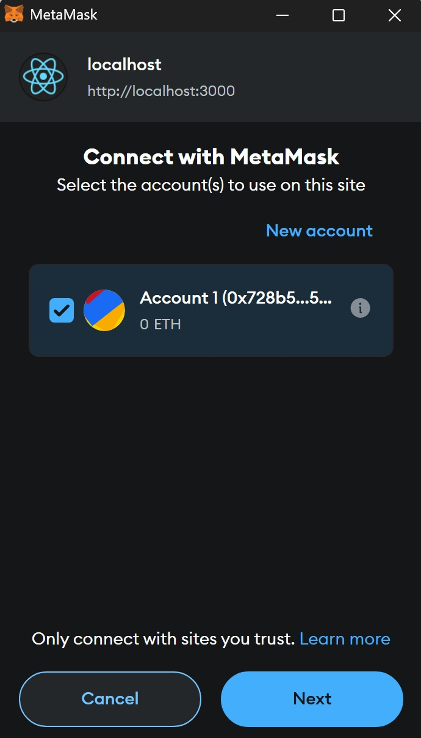
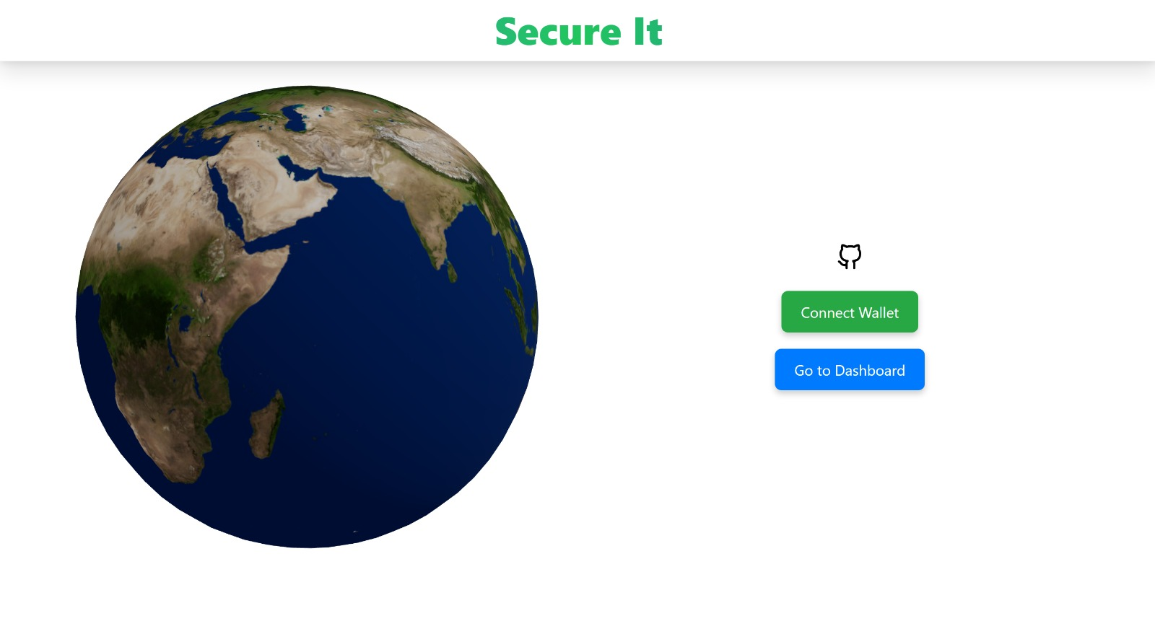
Code Bashers

Slide 5
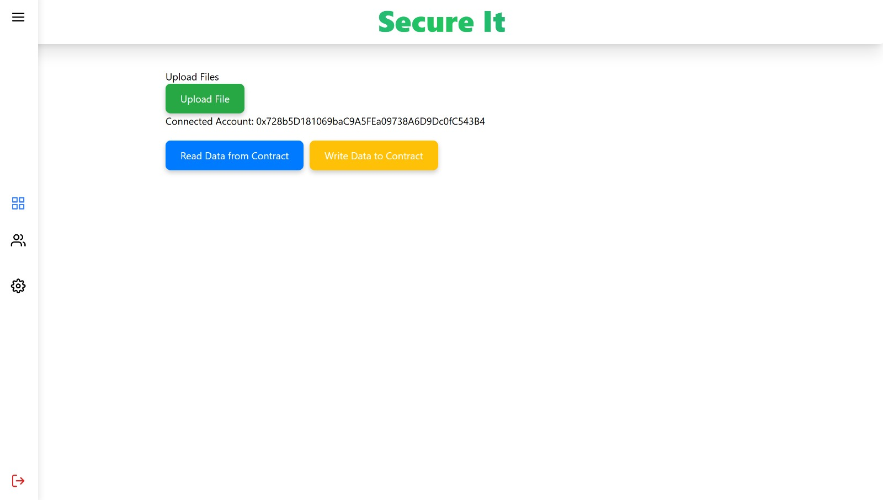
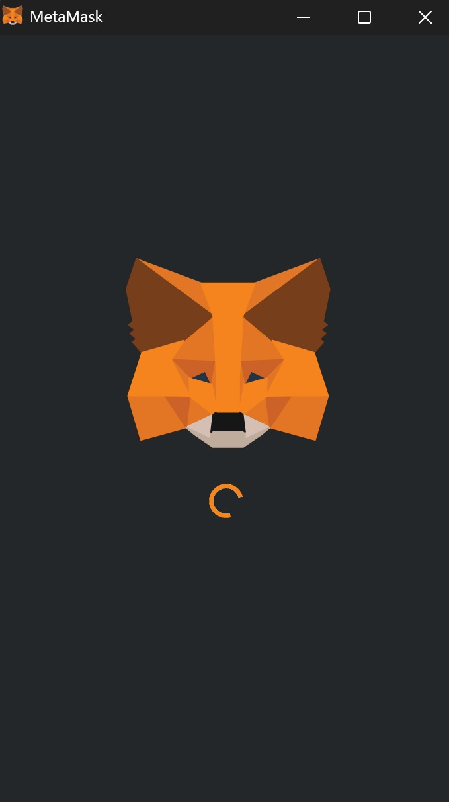
Code Bashers

Slide 6




Code Bashers
TECHNICAL APPROACH
Technologies used
React.JS Library: For the Front end of the application
Ethereum : Blockchain Platform Used
Solidity : For writing Smart Contracts
Remix-IDE : For testing the Prototype
Application Binary Interface: A special JSON file to make the solidity code interact with React.JS
Frameworks: Ether.js, Web3 Modal
MetaMask: Online extension for integrating wallet into the application.

Slide 7
[Team Name]
User WorkFlow
Create an Account: Users create an account on the platform and set up their MetaMask wallet, which securely stores their tokens and manages transactions.
Upload and Manage Data: Users can upload their personal data, set permissions for access, and define conditions for data sharing.
Receive Compensation: When a third party requests access to the data, a transaction is triggered. Upon user approval, the data is shared, and the user receives compensation in the form of tokens.
Monitor Data Usage: Users can view all the transactions and access requests related to their data, providing them with a transparent overview of how their information is used.

Slide 8
Code Bashers
Challenges
Scalability Issues: Ethereum currently faces scalability issues with high gas fees and slow transaction times, especially during network congestion. This could affect user experience and the platform’s ability to handle a large number of users or transactions. Data Privacy and Storage: While the platform manages data permissions and transactions, storing actual personal data on the blockchain or public storage networks poses privacy risks. A robust encryption mechanism and off-chain storage solutions would be required. Integration Complexity: Integrating multiple technologies (React, Ethers.js, MetaMask, Solidity smart contracts) and ensuring smooth communication between them can be complex and requires skilled developers.

Slide 9
Code Bashers
IMPACT
Enhanced Data Control: Users gain full control over their personal data, deciding who accesses it and under what conditions, fostering trust and security.Monetization Opportunities: Provides individuals with new avenues to earn rewards or compensation by sharing their data with authorized third parties. Privacy and Security Assurance: Offers a secure, tamper-proof environment with transparent audit trails, protecting users from data misuse and breaches. Empowerment and Autonomy: Empowers users to reclaim ownership of their data, shifting the power from centralized entities to individuals. Regulatory Compliance: Helps businesses comply with data privacy regulations, enhancing trust and reducing legal risks.Benefits of the solution (Social, Economic, environmental etc.).

Slide 10
Code Bashers
BENEFITS
The socio-economic benefits of the blockchain-based personal data sovereignty platform include Data Ownership and Equity: Empowers individuals by giving them ownership and control over their personal data, creating a more equitable digital economy. New Income Streams: Enables users to monetize their data, providing additional income opportunities, especially for those in underserved or marginalized communities. Transparency and Trust: Builds trust between users and organizations through transparent data usage and compensation mechanisms, encouraging more ethical data practices. Reduced Data Breach Costs: For businesses, secure data management reduces the costs associated with data breaches, legal fines, and regulatory compliance. Innovation and Market Growth: Promotes innovation in data-driven industries by fostering a marketplace for fair data exchange, potentially driving economic growth and new business models.

Slide 11
Code Bashers
CONCLUSION
This platform has the potential to revolutionize personal data management and sharing. By providing a secure, decentralized, and user-controlled environment, we empower individuals to reclaim ownership and control over their data. This platform establishes a foundation for a data privacy economy, where users can benefit from sharing their data while maintaining complete control over its usage and ensuring fair compensation. Future development will focus on integrating Al for enhanced data management, collaborating with third-party companies to unlock new applications, and fostering a data privacy economy where users are truly in control of their own digital identities.
As the platform evolves, it aims to set a new standard for how personal information is managed and secured, creating a more transparent and equitable digital landscape.

Slide 12
Code Bashers
THANK YOU RESPECTED
JUDGES !!!
for(int i=1;i<=10;i--) printf("THANK YOU !!!")
We deeply appreciate the time and effort you've taken to review our project.
Your insights and expertise are truly invaluable, and we are honored to
present our Blockchain-Based Personal Data Sovereignty Platform to such a
distinguished panel of judges.
Your commitment to fostering innovation and supporting emerging
technologies inspires us and makes this hackathon an incredible experience.
Thank you for considering our ideas and for your thoughtful feedback. We are
excited about the future and look forward to any questions or comments you
may have.

